Slide 1


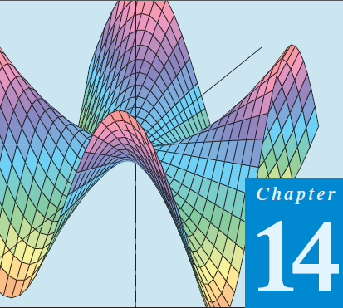
Thomas Calculus 11th
06
Applied Partial Derivatives
Samuel Lukas

Slide 2
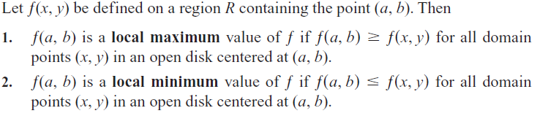
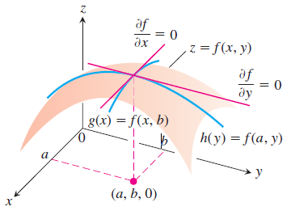
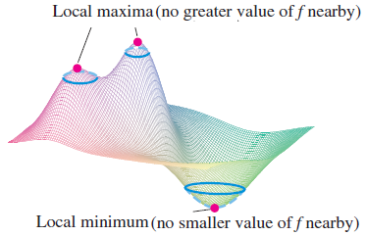
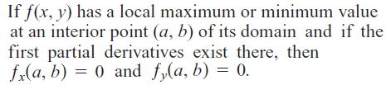
Local Maximum, Local Minimum

Slide 3
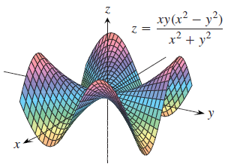
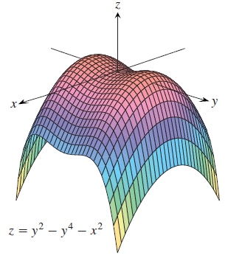
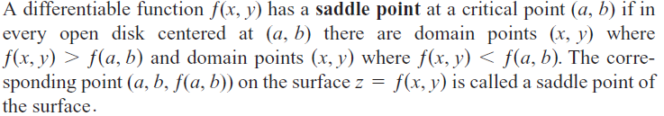
Critical and Saddle Point

Slide 4
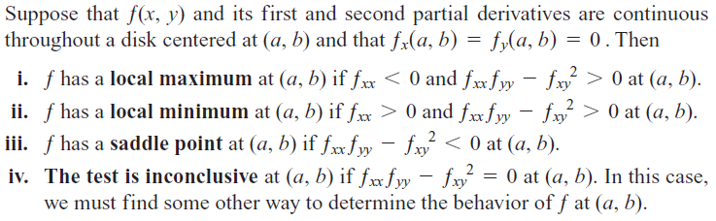
Second Derivative Test for Local Extreme Values

Slide 5
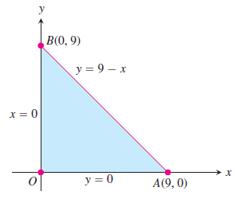







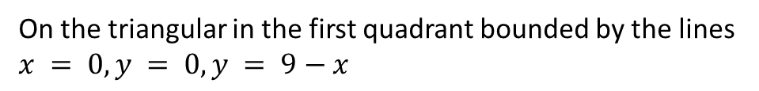
Find the absolute maximum and minimum values of
$$f\left(x,y\right)=2+2x+2y−x^{2}−y^{2}$$
On the triangular in the first quadrant bounded by the lines $x = 0, y = 0, y = 9−x$
Interior points
$$f_{x}=2−2x=0 →x=1$$
$$f_{y}=2−2y=0 →y=1$$
$$∴f\left(1,1\right)=4$$
Boundary points
$y=0 →f\left(x,y\right)=2+2x−x^{2} →f_{x}=2−2x=0→x=1, f\left(1,0\right)=3$
$0<x<9→f\left(0,0\right)=2 \& f\left(9,0\right)=−61$
$x=0 →f\left(x,y\right)=2+2y−y^{2} →f_{y}=2−2y=0→y=1, f\left(0,1\right)=3$
$0<y<9→f\left(0,0\right)=2 \& f\left(0,9\right)=−61$
$$y=9−x →f\left(x,y\right)=−61+18x−{2x}^{2} →f_{x}=18−4x=0→x=4.5$$
$f\left(4.5,4.5\right)=−20.5$
So, the minimum is $f(9,0)=f(0,9)=−61$and maximum is $f(1,1)=4$

Slide 6




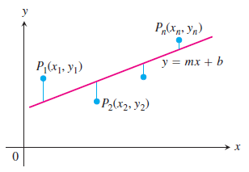
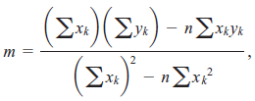

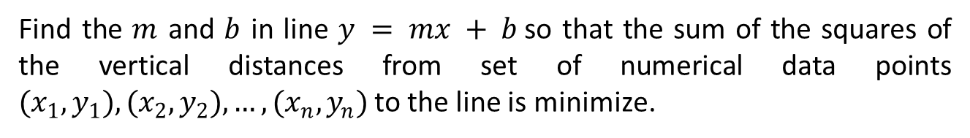
Exercises 1
Find all the local maxima, local minima, and saddle points of the functions
Find the $m$ and $b$ in line $y = mx + b$so that the sum of the squares of the vertical distances from set of numerical data points $(x_{1},y_{1}),(x_{2},y_{2}),…,(x_{n},y_{n})$to the line is minimize.

Slide 7
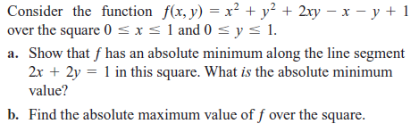
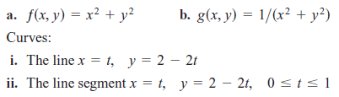
Find the absolute maximum and minimum values of the following functions on the given curves.

